Slide 1
NLH update 03/31

Slide 2
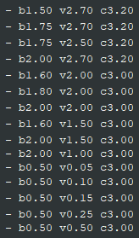
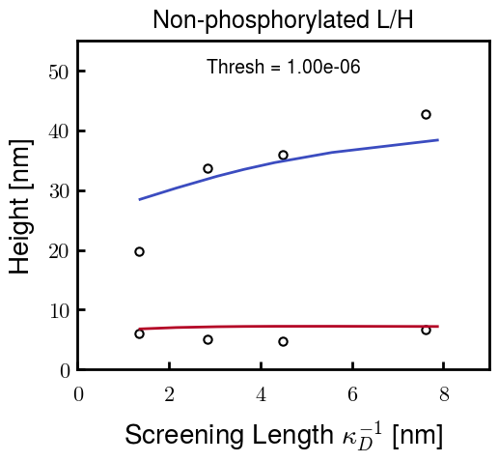


Original approach
Choose parameters for NFL and NFH independently
NFL Possibilities
NFH Possibilities
For example,
b: Kuhn length
v: Monomer volume
c: Flory Huggins parameter for
most hydrophobic residues

